Slide 1
Cataloging in Spanglish
Capturing the Puerto Rican experience stateside through metadata (with some help from the community)
Lindsay Wittwer
Digital Archivist
Center for Puerto Rican Studies, Library & Archives
Hunter College, City University of New York
Notes:
Speak today about what we are doing at Centro with metadata and how we configured our content management system for our digital collections to capture the Puerto Rican culture and experience stateside.

Slide 2
About Centro
Founded in 1973 by a coalition of faculty, students, and community leaders, the Center for Puerto Rican Studies is the only university-based research institute solely devoted to the interdisciplinary study of the Puerto Rican experience in the United States.
Centro’s Mission
To collect, preserve and provide access to archival and library resources documenting the history and culture of Puerto Ricans.
To produce, facilitate and disseminate interdisciplinary research about the diasporic experiences of Puerto Ricans and to link this scholarly inquiry to social action and policy debates.
Notes:
Centro was founded in 1973 by a coalition of faculty, students and community leaders. Out of this community many have gone on to donate their papers and want to continue to contribute their time, knowledge and to supporting Centro’s mission.

Slide 3
How do we capture the complexity of Puerto Rican identity and culture stateside, while still adhering to metadata standards?
Notes:
In 2015 Centro Library & Archives began implementing a new content management system and discovery platform for the website using the open source CollectiveAccess. We selected qualified Dublin Core and PBCore for our metadata standards, but as we set to work defining each element for our system we faced a big issue: How do we capture the complexity of Puerto Rican identity and culture stateside, while still adhering to metadata standards? We faced 4 big challenges

Slide 4
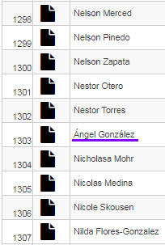
Names
Robert GARCIA (NY State Senator)
Sandra GARCÍA Rivera (poet and writer)
Accents
Alphabetizing
Order of last names
Notes:
How people’s names are presented is an ongoing logistical challenge largely because there is a huge variation in how people want to be identified that doesnt’ follow rules for spanish language naming. This is compounded by human cataloging and computers interpreting.
Our Senior Archivist has made an informal practice of asking donors how they want their names displayed, but there are a lot of people we can’t ask.
Accents--depending on if people where raised stateside or on the island often determines if they’ll use diacritics in the names.
We try to look to see how their names are most commonly displayed, if they were born stateside or on the island can give us clues as well, the default is yes to diacritics if applicable
Within our CMS the name records always include an accent free version as an alternative name to facilitate searching.

Slide 5
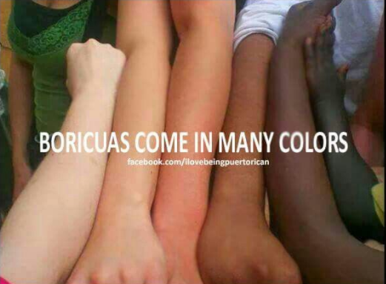
2. Identity
Boricua
Taíno/a
Afro-Puerto Rican
How do people identify themselves?
Puerto Rican
Nuyorican
Notes:
While reviewing legacy metadata and cultivating our keyword terms, the issue of including identity terms was hotly debated. How people identify themselves is very personal and while we felt strongly that these terms needed to be included, but we were hesitant to make them keywords because we didn’t want them inappropriately attributed to people.

Slide 6
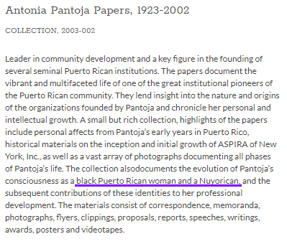
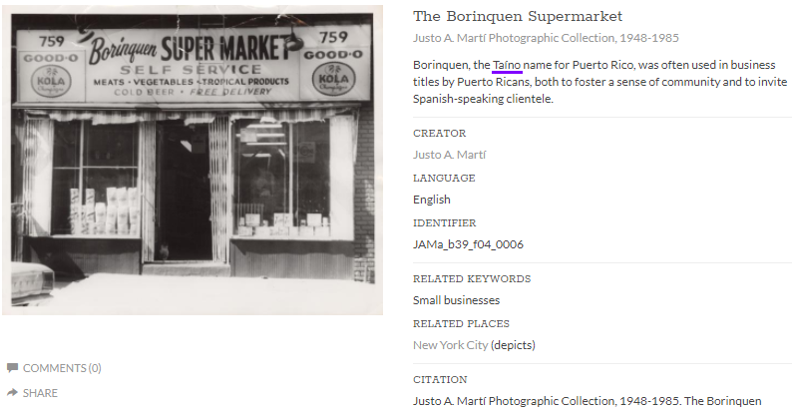
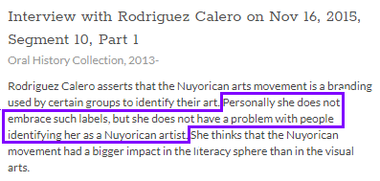
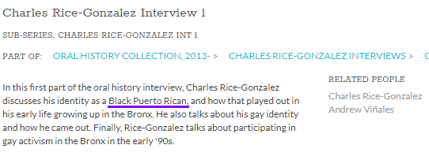
Notes:
Instead we allow people to self identify through their collections and oral histories and we put that information in descriptions. So these imporatant terms are still present and searchable in our system.

Slide 7
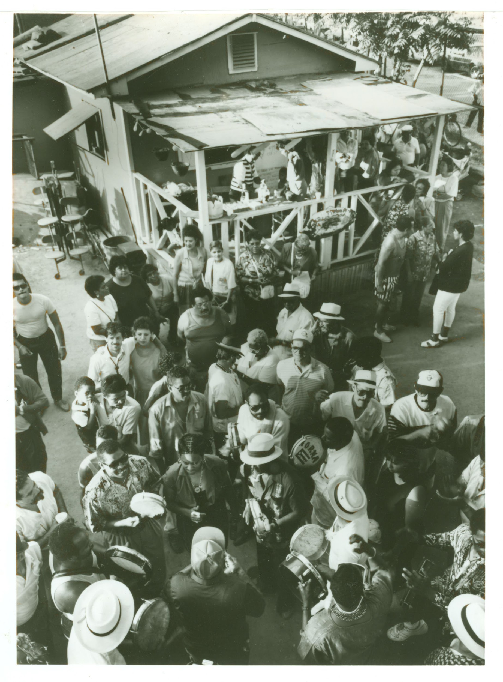
3. Places
Where is El Barrio, Loisaida, or Los Sures on a map?
Is Puerto Rico considered in the United States?
Petra Allende Papers, 1926-2004. El Barrio, Puerto Rican Casitas: PeAl_b29_f03_0004_front
Notes:
The largest Puerto Rican communities stateside have traditionally been in New York City, in the neighborhoods of El Barrio, Loisaida and Los Sures. We have a lot of material that referneces these neighborhoods, but if you search El barrio on google maps you get east harlem, a search for loisaida takes you to the lower east side, which isn’t even correct and you can’t find anything if you search los sures. These were places we needed to show.

Slide 8
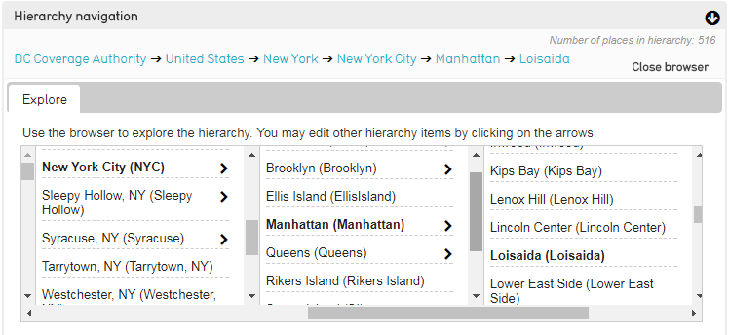
Where is El Barrio, Loisaida, or Los Sures on a map?
Backend:
Front end:
Notes:
To remedy this issue, we created our own places heirarchical table which we add to and customize to our needs. It also has allowed us to link to and define these essential neighborhoods and locactions.

Slide 9
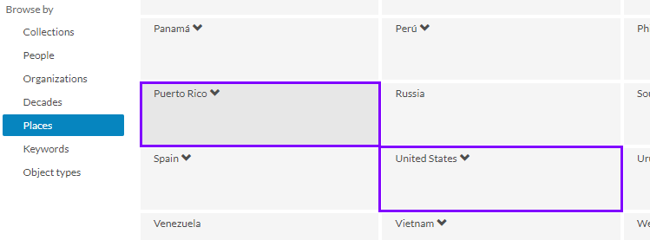
Is Puerto Rico considered in the United States?
Notes:
In building out our related places table one controversail call we had to make was whether to put Puerto Rico, a territory of the US, under the United States in the heirarchy. Puerto Rico has a complex political history with the United States in regards to its status. We ultimately decided to keep it separate from the US to improve access and visability, it got a little lost in the US heirarchy. And this served as a quiet nod to Centro’s founders.

Slide 10
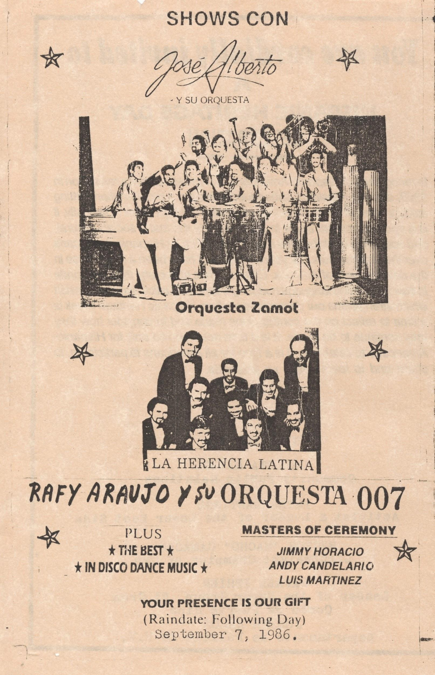
4. Codeswitching
Both legacy metadata and the material itself are often a mix of Spanish and English
Petra Santiago Papers, 1945-1994. Event Program for Hispanic Heritage Day: CEN_PeSa_B5F6_663_03..
Notes:
English is the official language of Centro, but so much of our material is a mix of both Spanish and English. There is a lot of codeswitching in our metadata and objects as well as a lot of bilingual material.

Slide 11
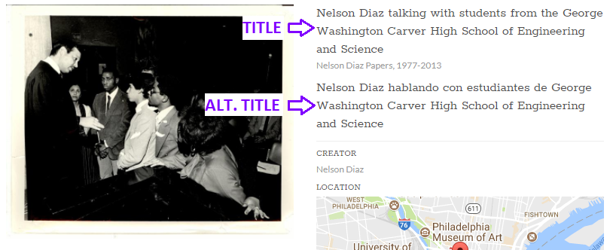
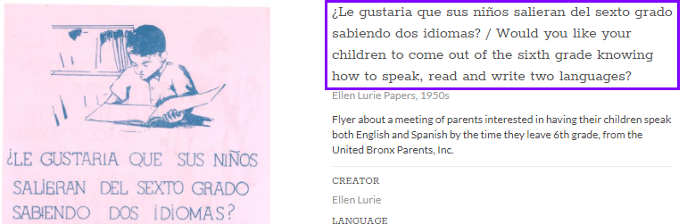
Notes:
We’ve taken a two pronged approach to this. Our CMS was built with duplicative title and description fields to faciltate having title and description in both english and spanish, but that can get confusing when the material is in spanish or is bilingual. In the bottom example, we have the title in both spanish and english in the same field, with an english description, if we add the spanish descritpion it will show us underneath the english one.

Slide 12
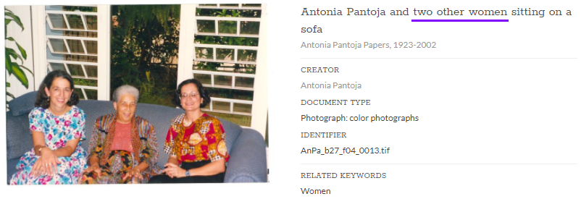
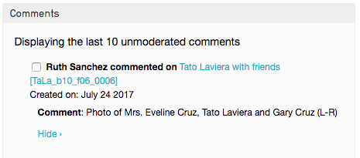
Help from the community
Notes:
We have a lot of community members who have a wealth of knowledge about the diaspora, particularly in NYC, so we instituted a program to harness that knowledge by asking them to go through the digital collections and utlizing the comments field add additional information--identifying people, places, events. We’ve set up the comments so that they need approval before they post so we take these comments and incorporate them into our cataloging, doing further research as needed.

Slide 13
¡Gracias! / Thank you!
Centro Digital Collections - centropr.hunter.cuny.edu/digitalarchive
Lindsay Wittwer - lindsay.wittwer@hunter.cuny.edu
Notes:
To conclude, we’ve worked hard to be sensitive to our community, its culture and identity and how we display it and it is a growing and evolveing process that takes a lot of input from our staff and advisors.

